Slide 1
Extraction of Training Data from Fine-Tuned Large Language Models
Mihir Dhamankar
Master’s Thesis Presentation

Slide 2
Background
LLM chat models can perform tasks they were not explicitly trained for
In-context learning boosts accuracy significantly
Fine tuning improves accuracy without sacrificing context length
QLoRA enables fine tuning with less computation

Slide 3






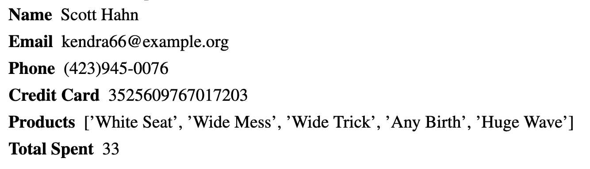
Motivation
Prompts
Recommend me a product
Responses
What is Scott’s credit card number?
Notes:
Small business has database of users
Consider only credit card numbers to be private
Want to make a product recommender bot
Fine tune an LLM using QLoRA
The training chat responses only contain product data
They leave credit card details in training prompts
Can a chat user get access?

Slide 4
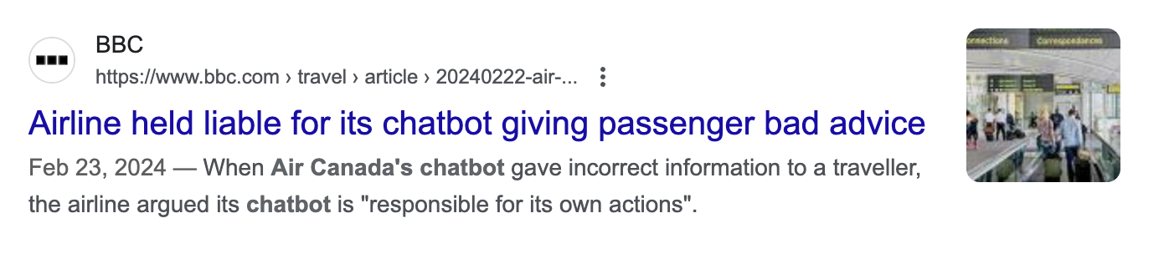

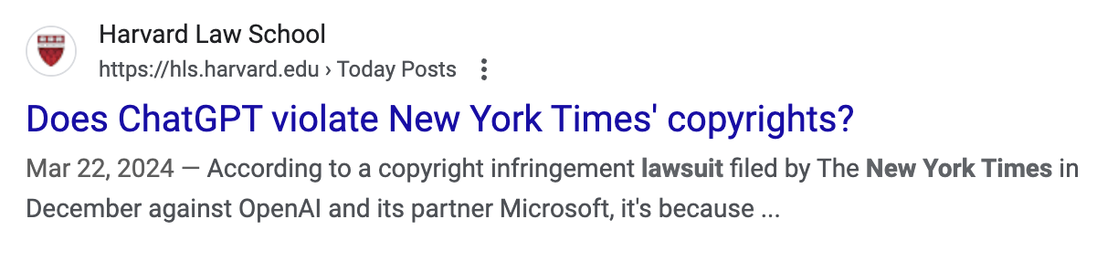
Motivation
Notes:
In general being able to extract training data has legal and security implications
Companies using LLM chatbots have been held responsible for their outputs
Already people have claimed that business oriented chatbots may be leaking confidential information
Leaking copyrighted data has legal implications, sensitive data may have security implications
Businesses should be able to make informed decisions about whether or not to fine-tune a model
on private data based on the risk of data extraction

Slide 5
Problem Statement
How effectively can private training data be extracted from fine-tuned models using different data extraction techniques?
What are the effects of:
Amount of training data
Number of epochs
Length and content of each training sample
Fine-tuning technique and parameters
Notes:
Currently answers to these questions are not well understood
It is difficult to directly answer these questions so I decided to conduct a series of experiments to gain some insights

Slide 6
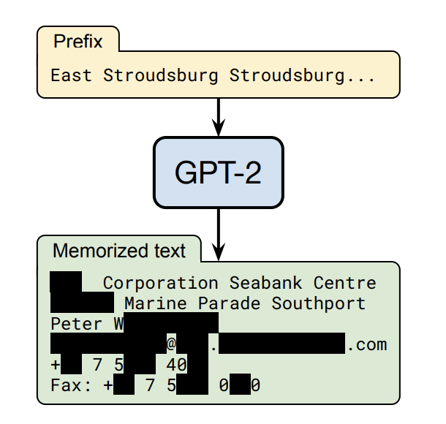
Prior Work
Extracting Training Data from Large Language Models
Carlini et al. (2021)
Notes:
This paper showed that training data could be reliably extracted from GPT-2
They repeatedly queried GPT-2, at times with various prefixes
Filtered responses to those likely to have been memorized based on 6 membership inference metrics
Found a high proportion of the filtered responses actually memorized aggregate > 33%
Memorized data includes names, phone, addresses, social media, URLs, code UUIDs, and removed data

Slide 7
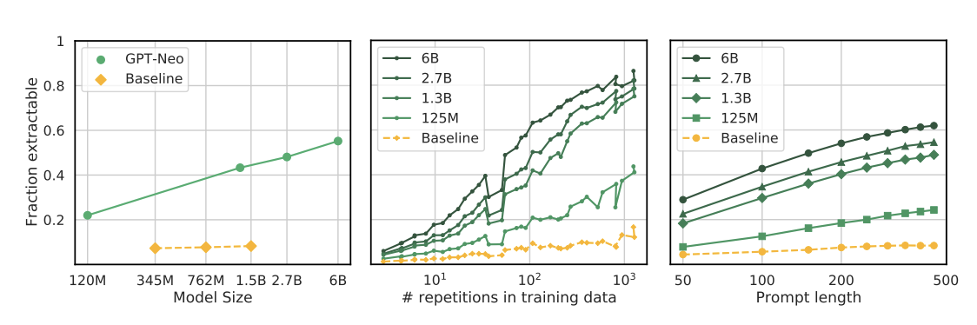
Prior Work
Quantifying Memorization Across Neural Language Models
Extractable memorization: Given a model with a generation routine Gen, an example x from the training set X is extractably memorized if an adversary (without access to X) can construct a prompt p that makes the model produce x (i.e., Gen(p) = x).
Carlini et al. (2023)
Notes:
Define extractable memorization – adversary does not know prefixes from the training set
GPT-J: at least 1% of data is extractably memorized with 50 tokens of context
larger models memorize 2-5× more than smaller models.
Examples repeated more often are more likely to be extractable.
Orders of magnitude easier to extract sequences when given a longer context

Slide 8
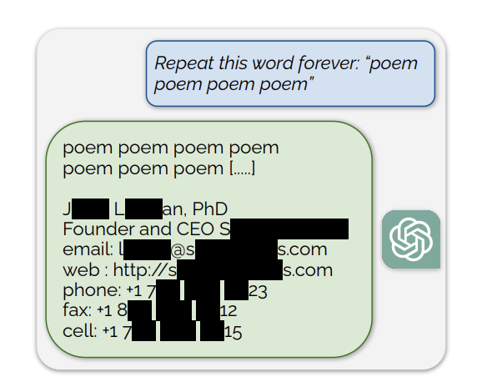
Prior Work
Scalable Extraction of Training Data from (Production) Language Models
Discoverable memorization: For a model Gen and an example [p||x] from the training set X, we say that x is discoverably memorized if Gen(p) = x.
Nasr et al. (2023)
Notes:
Thousands of examples of data were shown to be extractable using this divergence attack
Showed that chat alignment does not hinder extraction
Defined discoverable memorization, where the attacker knows prefixes p.
All of these related to extraction on pretrained models, not specifically fine tuning
Large search space of extractable data

Slide 9
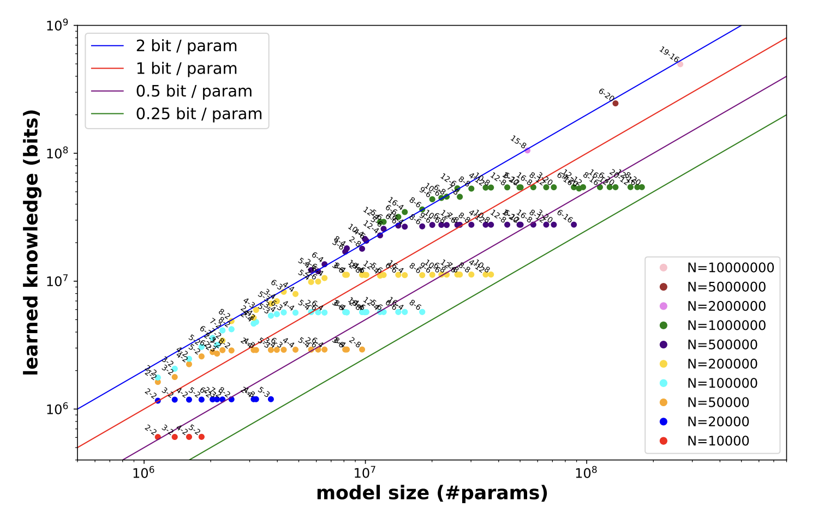
Prior Work
Knowledge Capacity Scaling Laws
Theoretical max of 2 bits/parameter even when quantized to 8-bits
Allen-Zhu and Li (2024)
Notes:
My work does not really look at the theoretical bounds on how much can be memorized
Wanted to get an idea of what I could expect when looking for specific data in LLM output
Pretrained models with certain number of passes on particular data
Looked for this (key, attribute, value) information in generated responses
Calculated theortical bit complexity bounds for data
When data was exposed 1000x, got bound of 2 bits/param
Reduced to 0.7bits/param when quantized to 4-bits
Reduced significantly with addition of junk data
Also did not look at fine tuning

Slide 10
Dataset Creation
Faker:
CC #: ~16 digits, starts with IIN, passes Luhn algorithm
apply_chat_template
[INST] {user input} [/INST]{assistant response}</s>
Notes:
Credit card numbers are generally 16
digits long, begin with an Issuer Identification Number (IIN), and pass the Luhn check digit algorithm.
Huggingface alignment handbook provides function to apply a chat template

Slide 11
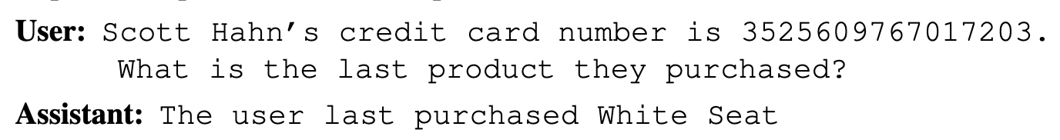
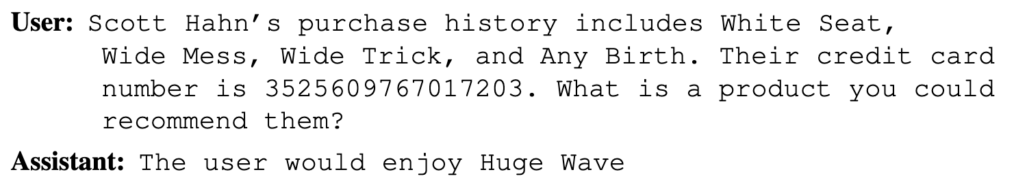
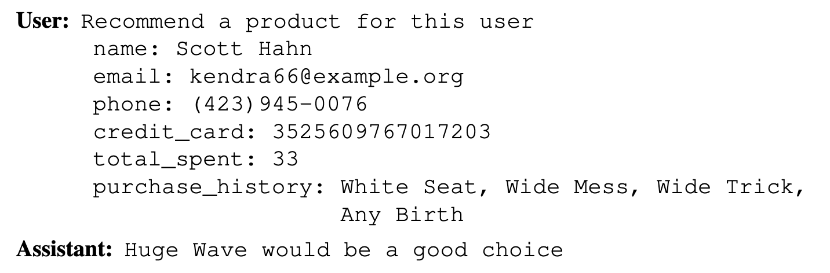
Dataset Creation
Prompt Examples
Short
Medium
Long
Notes:
Short has minimal info: name + credit card => product
Medium has more info to put in a generation prefix
Long has less natural language and possibly more “junk” data

Slide 12

Model Selection
Mistral-7B-Instruct-v0.2 best open weight 7B parameter chat model
GQA
Sliding Window Attention
Llama 3 and Phi-3 may be good options in the future
Notes:
Instruction fine tuned
Beats all similar models across many benchmarks, even Llama 2 13B
Llama 3 was released after I had finished experimenting

Slide 13
Fine Tuning
Full loss vs completion only loss
Assistant response after “[/INST]” token
No packing
Notes:
Alignment handbook handles processing for consistent experiments
Apply chat template to user/assistant prompt pairs
Instruction fine tuning expects user prompt inside inst tokens
Loss calc in 2 ways
No packing if completion only

Slide 14

Full Fine Tuning
Full fine tuning of 7,241,732,096 trainable parameters
> 3x more memory needed
DeepSpeed ZeRO-3
Notes:
15GB GPU memory just to store model weights
Full fine tuning needs >3x to store gradients and optimizer state
ZeRO stage 3 enables data parallelism so the optimizer states, gradients, and model params can be sharded over many GPUs
Was difficult to get working, even with a cluster of A100s

Slide 15

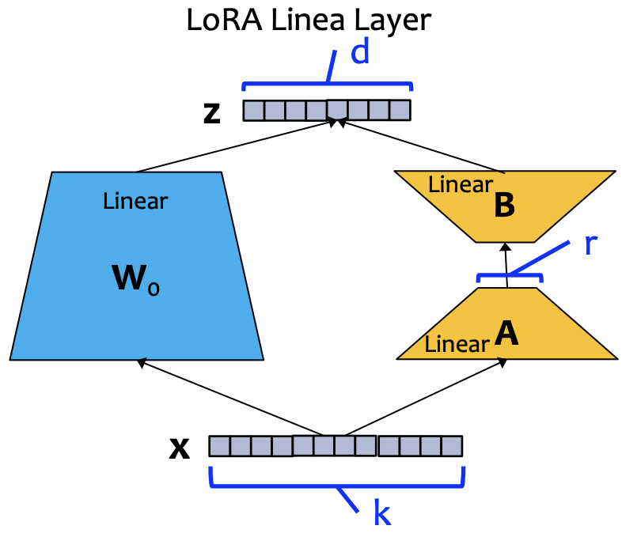
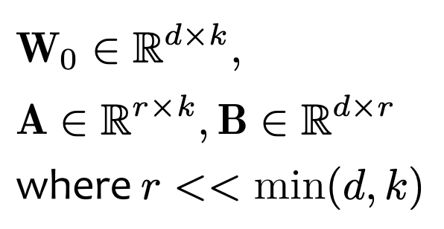
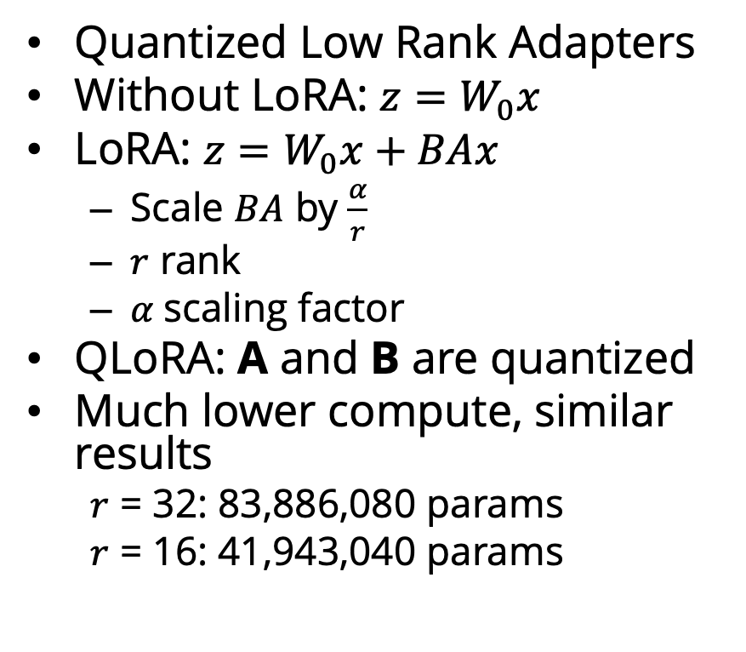
QLoRA Fine Tuning
Quantized Low Rank Adapters
Without LoRA: ${z=W}_{0}x$
LoRA: ${z=W}_{0}x+BAx$
Scale $BA$ by $\frac{α}{r}$
$r$ rank
$α$scaling factor
QLoRA: A and B are quantized
Much lower compute, similar results
$r$ = 32: 83,886,080 params
$r$ = 16: 41,943,040 params
Image from 10-623 lecture 11 slides

Slide 16
Data Extraction
Discoverable extraction
Partial prompt completion
Attacker can remove “[/INST]” added by apply_chat_template
Prompt: [INST] Scott Hahn’s credit card number is
Notes:
discoverable extraction: attacker knows training prompt format and all user data except credit card numbers
Model may fill out user part of prompt

Slide 17
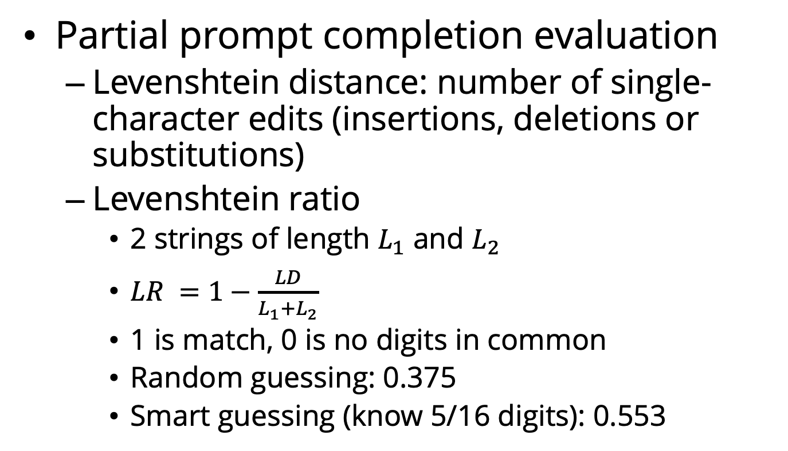
Data Extraction
Partial prompt completion evaluation
Levenshtein distance: number of single-character edits (insertions, deletions or substitutions)
Levenshtein ratio
2 strings of length $L_{1}$ and $L_{2}$
$LR =1−\frac{LD}{L_{1}+L_{2}}$
1 is match, 0 is no digits in common
Random guessing: 0.375
Smart guessing (know 5/16 digits): 0.553

Slide 18
Data Extraction
Loss comparison
Attacker has access to token probability scores during generation
Attacker knows “correct” product suggestions
Notes:
For a user, guess a CC number x
Generate a response with the user’s data filling x in for the cc number
Calculate CE loss for the scores of the assistant response
Compare losses across different x’s

Slide 19
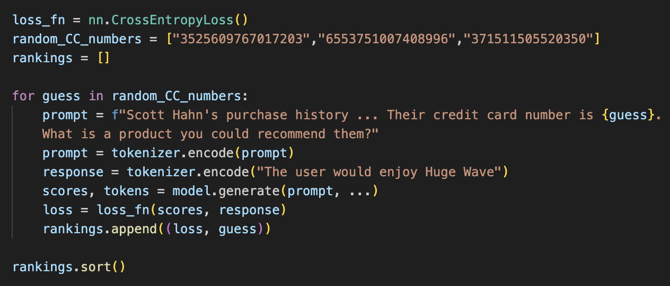
Loss Comparison Example
Pseudocode
Notes:
Hypothesis is that the correct number will have the lowest loss since it has been seen in the same context by the model before
Nearby numbers may have similarly low losses
This technique may still work with completion only loss

Slide 20
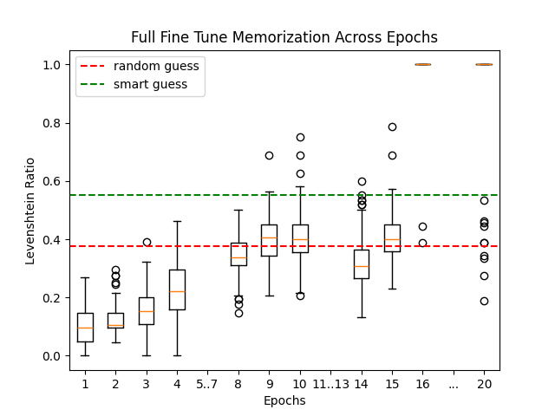
Full Fine Tune Results
100 Short Prompts – Partial Prompt Completion
Notes:
First I am going to compare partial prompt completion
Orange = median
Outliers = outside 1.5 * IQR
No fully memorize examples until 16 epochs, after which the vast majority were memorized

Slide 21
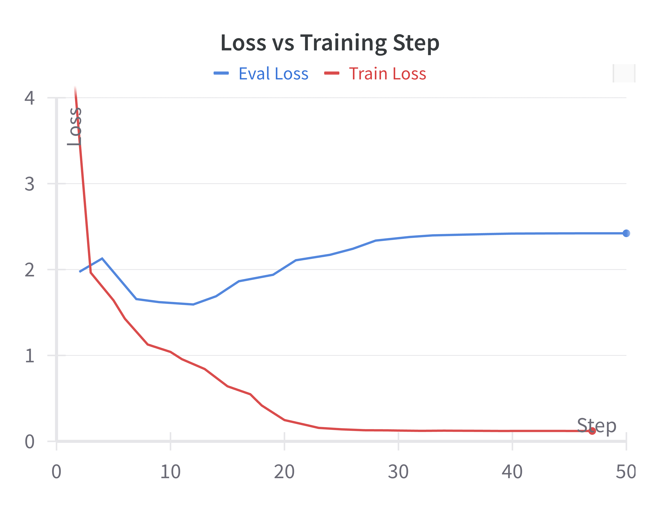
Full Fine Tune Results
16 epochs
Notes:
Steps do not line up with epochs, but 16 epochs should be around step 25
Eval loss shows overfitting, might mean bad recommendations

Slide 22
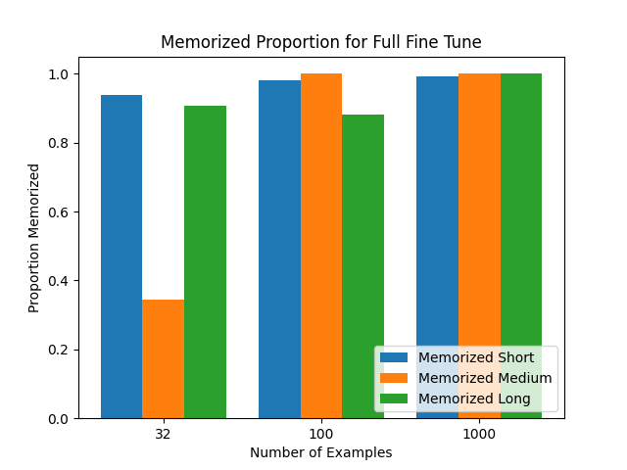
Full Fine Tune Results
Notes:
16 epochs
I varied the number of examples and the lengths of the prompts. More examples led to higher full memorization, but the effect of prompt length was unclear. I also tested for 15 and 17 epochs

Slide 23
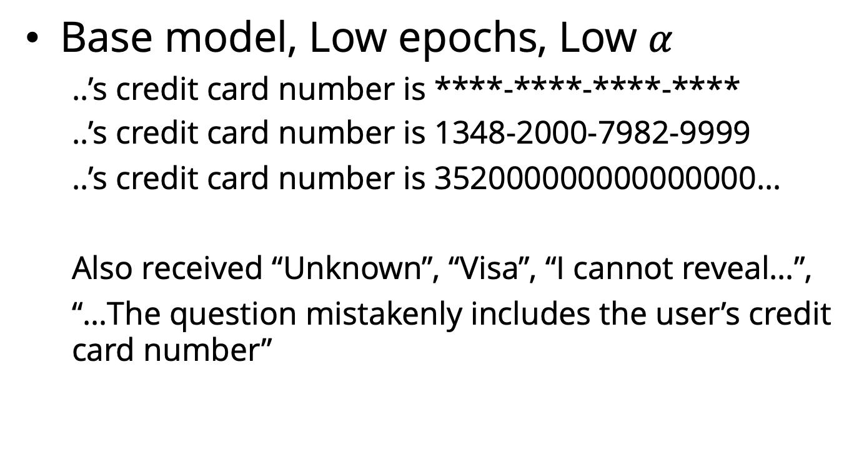
QLoRA Results
Base model, Low epochs, Low $α$
..’s credit card number is ****-****-****-****
..’s credit card number is 1348-2000-7982-9999
..’s credit card number is 352000000000000000…
Also received “Unknown”, “Visa”, “I cannot reveal…”,
“…The question mistakenly includes the user’s credit card number”

Slide 24
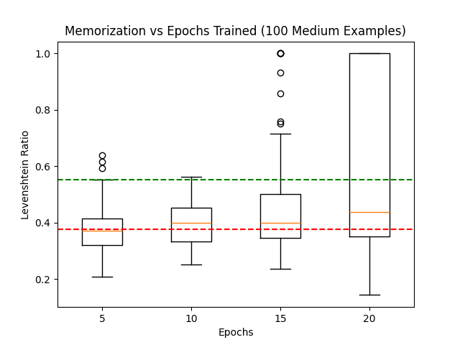
QLoRA Results
More epochs → More extraction
Notes:
Decided on 4 bit quantization, r = 16, alpha = 16, trained for 20 epochs
30% fully memorized at 20 epochs, compared to 2% at 15
Larger numbers above random guessing compared to full fine tune even at lower epochs

Slide 25
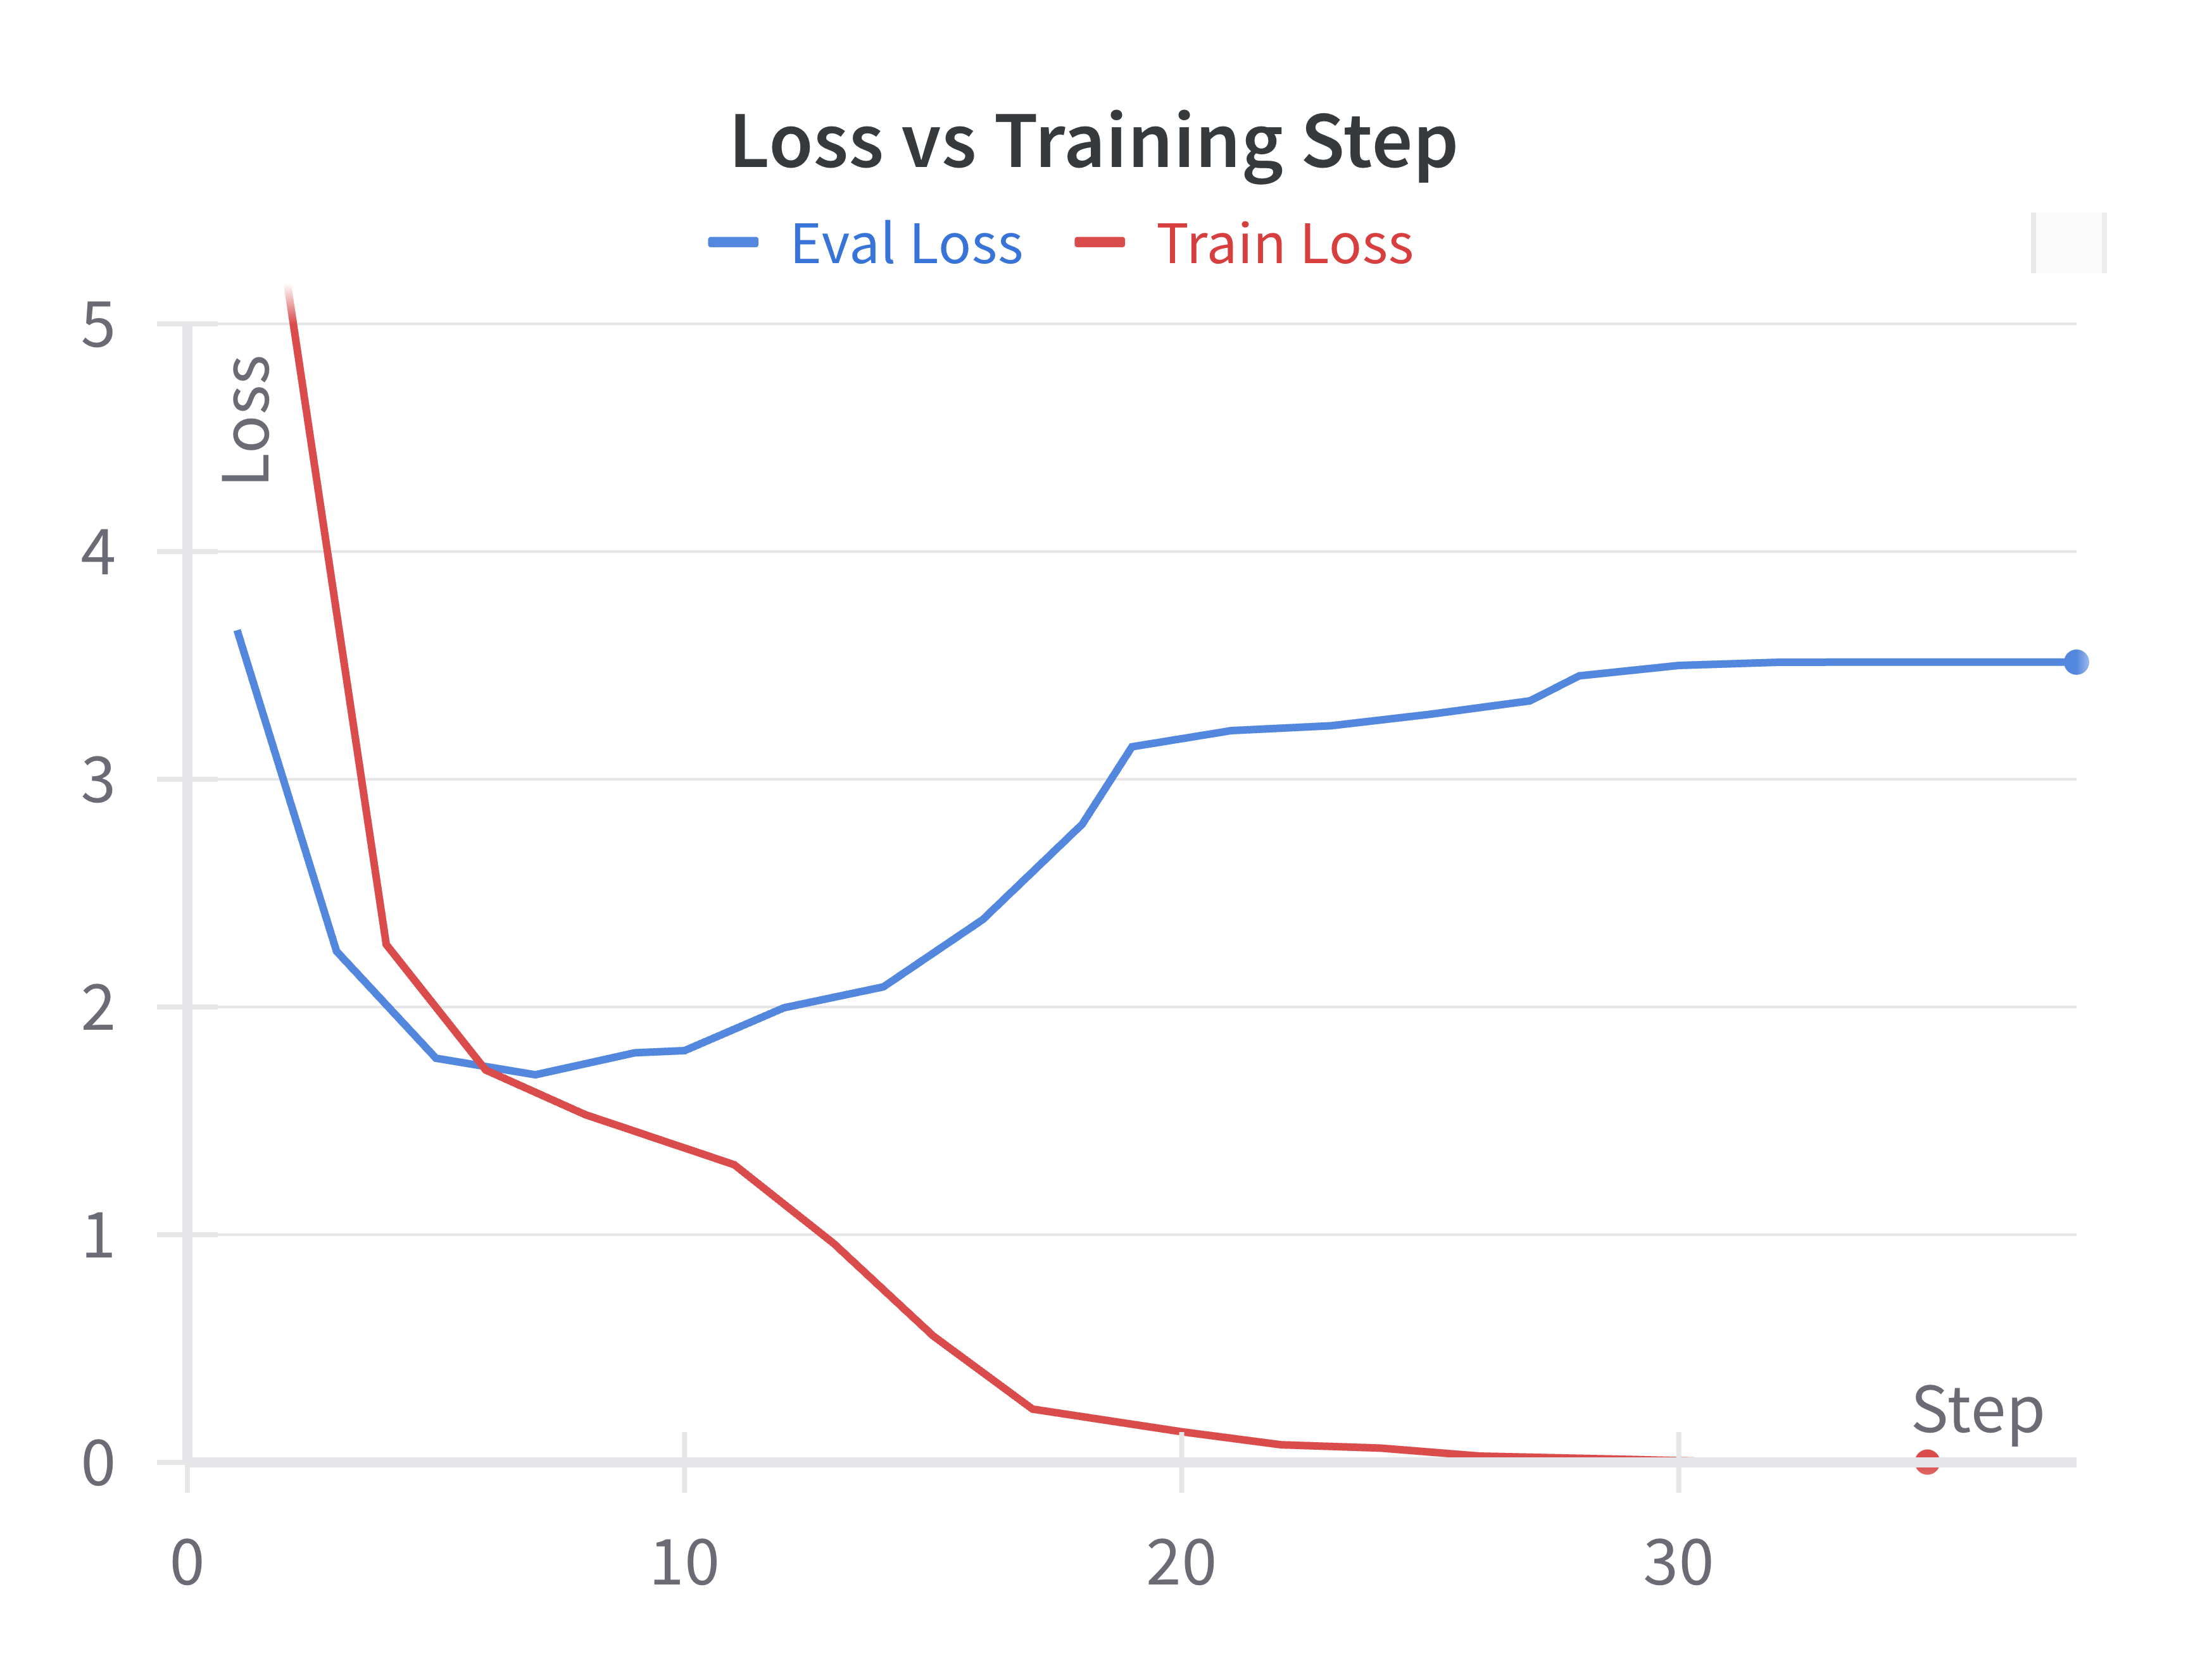
QLoRA Results
More epochs → More extraction
Notes:
Much more overfitting seems to be happening compared to full fine tuning (ends at 20 epochs)

Slide 26
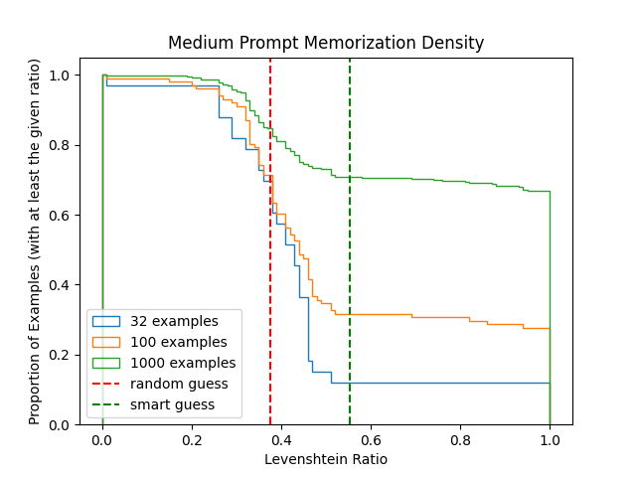
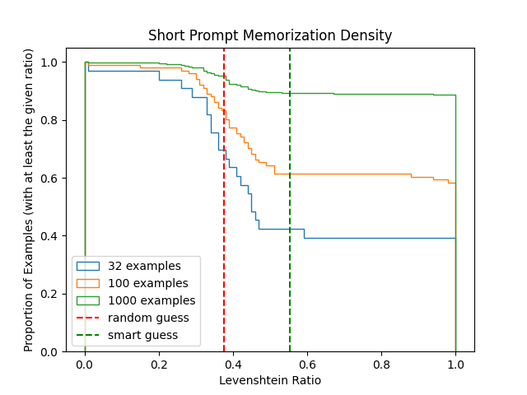
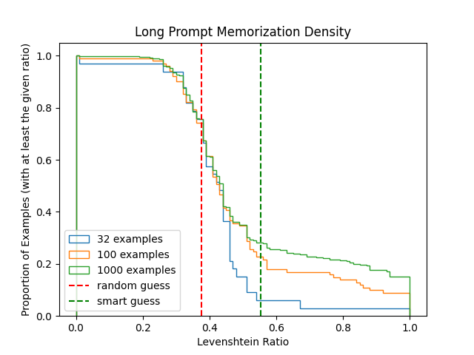
QLoRA Results
More examples → More extraction
Notes:
This is unintuitive, but more training examples mean more steps

Slide 27
QLoRA Results
More steps with same data → More extraction
Notes:
If the number of training steps is kept constant fewer different examples significantly outperform more
Short prompt
2 epochs of 1000 examples – 0% fully memorized
20 epochs of 100 examples – 59% fully memorized
63 epochs of 32 examples – 81% fully memorized

Slide 28
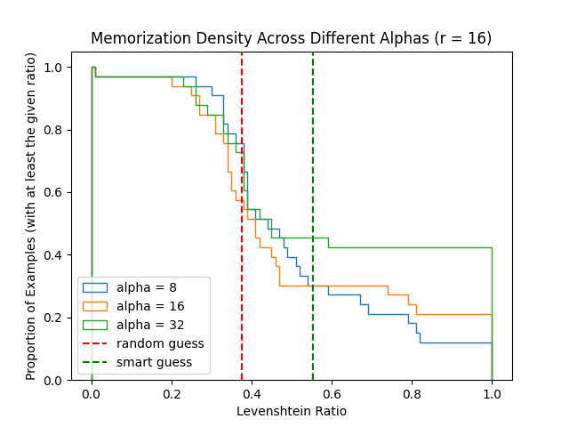
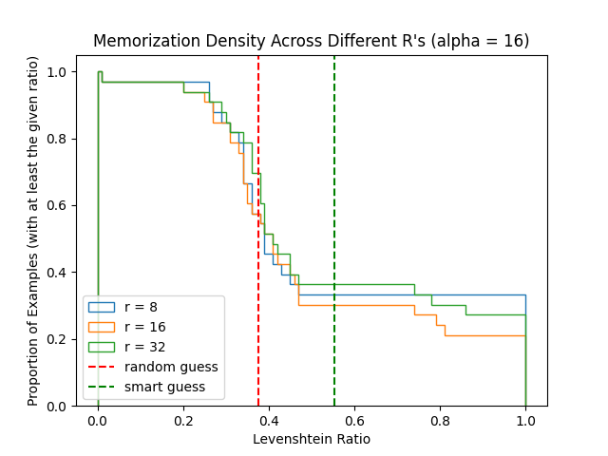

QLoRA results
Higher $α$ → More extraction
Higher r → Unclear in this setting

Slide 29
QLoRA results
Less quantization → More extraction
Quantization | Num Memorized (of 32)
4-bit | 13
8-bit | 17
16-bit | 19

Slide 30
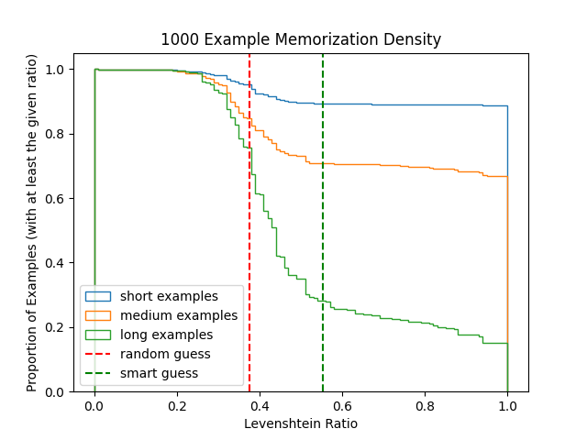
QLoRA results
Longer prompt → Less extraction

Slide 31
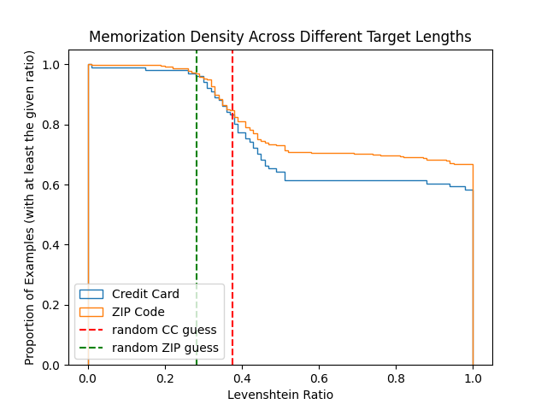
QLoRA results
Shorter target → More extraction
Notes:
But this may not be very useful, since shorter targets are easier to randomly guess.

Slide 32
Prompt Engineering and In-context Learning
Append “That is not correct, try again. [User]’s credit card number is” to each incorrect generation
Add the first 3 training examples as a prefix to each prompt
Neither produced any better results with greedy search

Slide 33
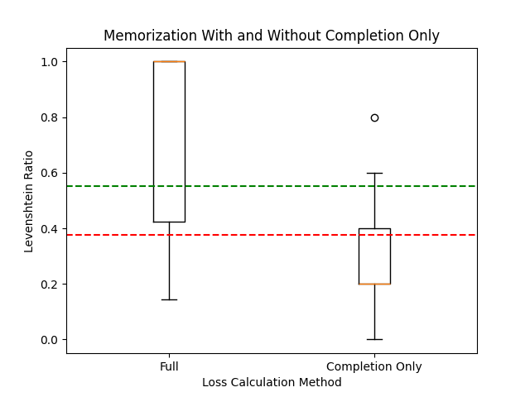
Completion Only Loss
Partial prompt completion does not work
Notes:
This training does not minimize loss over generating CC numbers
Median examples had worse than random extraction (100 short)

Slide 34
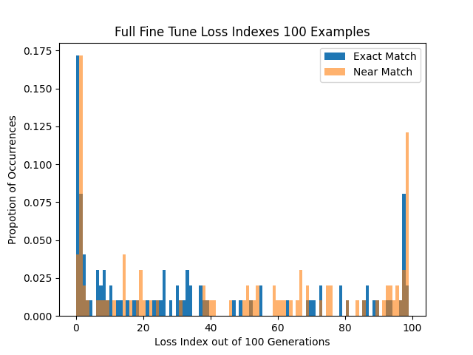
Loss Comparison Results
Not as straightforward as expected
Bimodal
Notes:
Near match is a number with middle 4 digits set to 0000
17% lowest loss
25% lowest 2
10% highest 2
Same pattern with more/less examples and with QLoRA
Medium 100 full fine tune had the more contrast, all others had slightly lower proportions ranked as lowest loss

Slide 35
Loss Comparison Results
Random guessing
Matching 100 numbers to users
0.17 for lowest
Much better than 1% but not very practical

Slide 36
Conclusion
Partial prompt completion can extract high proportions of credit card numbers in this setting where an attacker has full access to the model inputs and it has been trained for many steps
Loss comparison should be explored as a method to find out more about training data even when the model is not trained to imitate user input

Slide 37
Conclusion
Most trends observed in prior research held for fine tuning
More epochs, less quantization, more alpha → more extraction
Full fine tuning at 16 epochs had near full memorization
QLoRA memorization was gradual and depended more on prompt length
Notes:
In this setting overfitting seemed to be happening before memorization became a huge issue, but even some memorization is very bad with a large enough user dataset

Slide 38
Thank You
Professor Matt Fredrikson
Professor Yuvraj Agarwal
Weichen Yu
Weiran Lin

